Slide 1

ML-Fiesta Synergy'24 Project Documentation
By Code Wizards
Project Name: SandalQuest

Slide 2
Team Members
Shani Sinojiya (Team Lead / AI/ML & Backend Developer)
Mohammad Anas Africawala (AI/ML Engineer)
Tisha Patel (Full Stack Developer)

Slide 3
Project Overview
The goal is to utilize AI and machine learning to develop a pipeline that processes and understands audio content related to sandalwood cultivation. We are focusing on creating an Automatic Speech Recognition (ASR) model for the Kannada language and a speech-based question-answering system that will help users easily access information from the audio data.
Project Objectives:
Develop an ASR model that can accurately recognize colloquial Kannada speech.
Create a searchable audio database using the ASR output.
Implement a question-answering system allowing users to ask questions via speech input.

Slide 4
Problem Statement
Karnataka is a key region for sandalwood, which holds significant cultural, religious, and economic value in India. However, much of the traditional knowledge around sandalwood cultivation is conveyed informally and captured in audio recordings. These resources are not easily accessible, and there's a need to digitize and preserve this indigenous knowledge. The main challenge is handling colloquial Kannada speech with background noise, as it differs from standard formal language.
Challenges:
Limited digital information on sandalwood cultivation.
Audio recordings often contain noise and informal language.
Standard ASR models struggle with colloquial language.

Slide 5
Scope
The project includes:
Building a Kannada ASR model for colloquial language recognition.
Creating a searchable database by transcribing audio files.
Developing a speech-based question-answering system to query the audio corpus.
Fine-tuning the ASR model using both provided and publicly available Kannada datasets.
Out of Scope:
Processing audio in languages other than Kannada.
Real-time transcription of live streams.
Handling complex multi-turn dialogues.

Slide 6
Dataset Description
Source: Audio files scraped from YouTube.
Content Type: Informal Kannada speech, possibly with background noise.
Format: Common audio formats like MP3.

Slide 7
Dataset Challenges
Noisy recordings made in public spaces.
Informal and colloquial language use.
Variations in pronunciation and dialects.

Slide 8
Functional Requirements
Task 1: Speech Recognition
Develop an ASR model for Kannada speech from audio files.
Handle informal and colloquial speech.
Support model fine-tuning with additional datasets.
Key Features:
Kannada speech transcription to text.
Noise reduction and speech enhancement.
Accommodate dialect variations.
*Code Explanation is in GitHub Repository.

Slide 9
Functional Requirements
Task 2: Speech-based Question-Answering System
Allow users to ask questions via speech input.
Convert the spoken question to text using the ASR model.
Search the transcribed audio data for relevant answers.
Return the most relevant audio segment as the answer.
Key Features:
Accurate answer retrieval from speech queries.
Efficient search and indexing of the transcribed corpus.
User-friendly query and response interface.
*Code Explanation is in GitHub Repository.

Slide 10
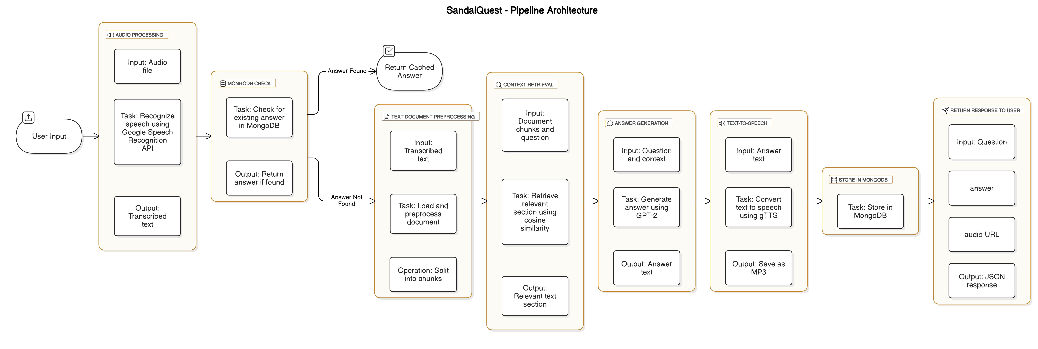
SandalQuest - Pipeline Architecture

Slide 11
Technical Requirements
Languages: Python.
Libraries & Frameworks: PyTorch, Whisper (ASR), Hugging Face Transformers.
Database: MongoDB
Deployment: Google Cloud Platform (GCP) or AWS for scalable processing.
Hardware: GPU servers for training, cloud instances for deployment.
Tools: Google Colab, Jupyter Notebooks, GitHub.

Slide 12
Risks & Mitigation
Risks
Mitigation
Low-quality audio data
Poor ASR accuracy on colloquial speech
High query processing latency
Use noise reduction and data augmentation
Fine-tune model with additional colloquial data
Optimize search algorithms and indexing

Slide 13
Conclusion
This project aims to document and provide access to indigenous knowledge of sandalwood cultivation through advanced ASR and NLP technologies. By building a robust pipeline, we will not only aid conservation but also provide valuable insights for users interested in sandalwood cultivation.

Slide 14
Project Links
Github Repository: Click me
Youtube Video: Click me

Slide 15
References
Whisper: A Speech Recognition Framework by OpenAI.
Hugging Face Transformers for NLP models.
Google Colab for collaborative coding.
MongoDB for database management.
PyTorch for deep learning models.
GitHub for version control and collaboration.

